Slide 1
Different Customization Approaches and Options for SOLIDWORKS PDM
By: Marc Young and Ilan Madjar
xLM Solutions, LLC
www.xlmsolutions.com

Slide 2
Overview
SOLIDWORKS PDM Customization Options
  Functions with in Data Cards
  Dispatch
  Advanced customization options
    Add-in
    Standalone Executable
    Tasks
Debugging and Testing
ROI Calculation
Conclusion

Slide 3
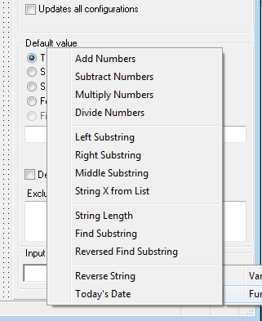
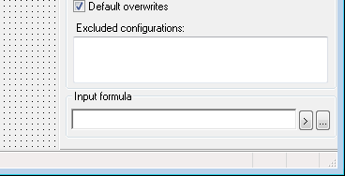
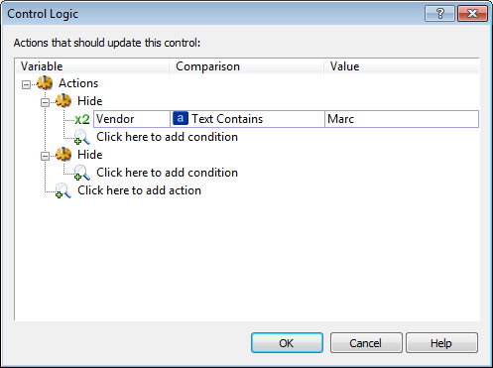
Customizations with in Data Cards
Input formula
  Allows to do simple string manipulation
Control Logic
  Hide or Gray out fields
Tabs – Controlled by Variables
Cascading Menus
Examples…

Slide 4
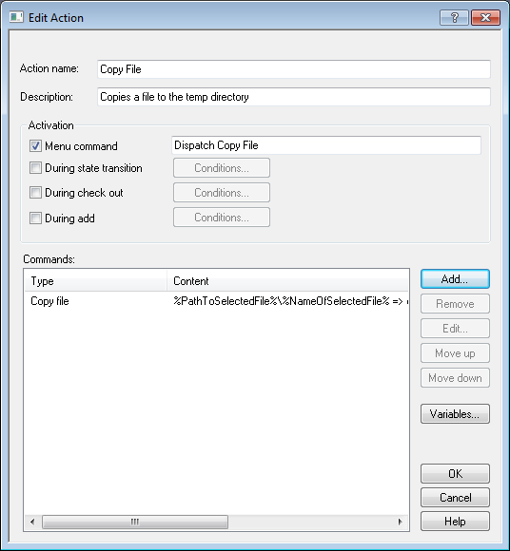
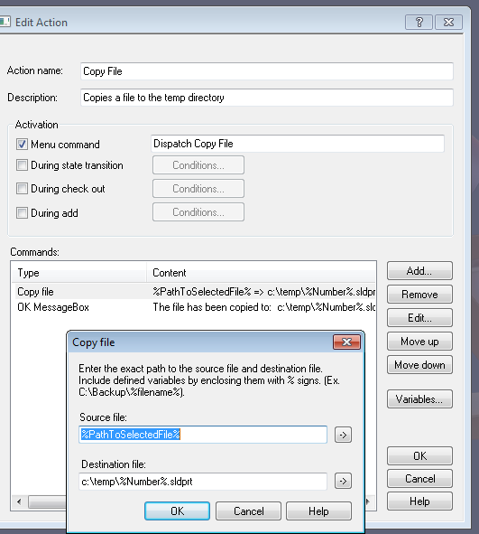
Dispatch
An SOLIDWORKS PDM Add-In that comes out of the box
Provides the ability add customization functionality with out
  In depth programming capabilities
  Programming environment such as Visual Studio
Example: Copy a file from SOLIDWORKS PDM to an outside directory and rename the file

Slide 5
Advanced Customization Options
SOLIDWORKS PDM has provided a robust API
Can be developed in different programming languages (VB.Net, C#, C++)
Documentation
  C:\Program Files\SolidWorks Enterprise PDM\API_GB.chm

Slide 6
“I do not want or need to customize the system”
Myths
Companies are hesitant to customize their SOLIDWORKS PDM installations for fear of
  Problems with upgrades (compatibility issues)
  Increased complexity
  System becomes unsupported
Facts
Many SOLIDWORKS PDM customers have implemented customizations
  APIs are largely compatible across versions
    e.g., SolidWorks/SOLIDWORKS PDM add-in are backward compatible
  Properly constructed Add-ins are easy to deploy and maintain
  Add-Ins may be disabled to aid in troubleshooting and diagnostics
  Add-Ins allow customers to harness the power of SOLIDWORKS PDM to develop and deploy optimized solutions for their enterprise PLM needs
  Customization may be need to data migrations –
    Examples DBWorks to SOLIDWORKS PDM or SOLIDWORKS PDM to Enovia V6
Challenge
To balance customization versus out-of-the-box functionalities

Slide 7
Add-Ins (1/4)
SOLIDWORKS PDM Events
Menu Command Lock (Pre / Post)
Card Button Move File (Pre / Post)
Card Input Move Folder (Pre / Post)
Card List Source Rename File (Pre / Post)
Add File (Pre / Post) Rename Folder (Pre / Post)
Add Folder (Pre / Post) Share File (Pre / Post)
File Copy (Pre / Post) Change State (Pre / Post)
Folder Copy (Pre / Post) Undo Check In (Pre / Post)
Delete File (Pre / Post) Check In (Pre / Post)
Delete Folder (Pre / Post) Serial No. (Pre / Post)
Get (Pre / Post)
An Add-In can be added to almost an event in SOLIDWORKS PDM
  It is run on the computer performing the event
Depending on the event different information is provided to the Add-In
For instance the Add File event provides the following:
  Pre (i) ID of parent Folder, (ii) Local file path and (iii) local or network path
  Post (i) ID of Parent folder, (ii) ID of file, (iii) full path to file and (iv) local or network path

Slide 8
Add-Ins (2/4)
To Create an Add-In:
Create a Class Library project
Reference in the PDMWorks Enterprise 6.4 (or specfic version) Library
  Add an import statement for the EdmLib library Imports EdmLib
Implement the EdmLib.IEdmAddIn5 Interface: Implements IEdmAddIn5
  From this interface you need to implement the follow two methods
Public Sub GetAddInInfo(ByRef poInfo As EdmLib.EdmAddInInfo, ByVal poVault As EdmLib.IEdmVault5, ByVal poCmdMgr As EdmLib.IEdmCmdMgr5) Implements EdmLib.IEdmAddIn5.GetAddInInfo
End Sub
Public Sub OnCmd(ByRef poCmd As EdmLib.EdmCmd, ByRef ppoData As System.Array) Implements EdmLib.IEdmAddIn5.OnCmd
End Sub

Slide 9
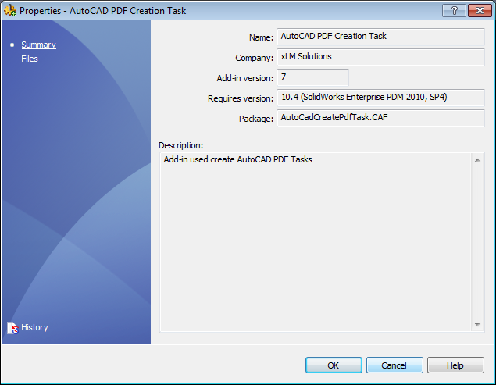
Add-Ins (3/4) – GetAddInInfo Subroutineon
GetAddInInfo method controls what is seen in the Add-In Properties window and what to register the command as:
Public Sub GetAddInInfo(ByRef poInfo As EdmAddInInfo, ByVal poVault As IEdmVault5, ByVal poCmdMgr As IEdmCmdMgr5) Implements IEdmAddIn5.GetAddInInfo ' Name of Add-In poInfo.mbsAddInName = "VB .Net AddIn" ' Name of company poInfo.mbsCompany = "My Company“ ' Description of Add-In poInfo.mbsDescription = "Menu AddIn that shows a messagebox“ ' Version of Add In poInfo.mlAddInVersion = 1 ' Minimum SolidWorks Enterprise PDM version needed for VB .Net Add-Ins is 6.4 poInfo.mlRequiredVersionMajor = 6 poInfo.mlRequiredVersionMinor = 4 ' Registers the type of add it is poCmdMgr.AddCmd(1, "VB .Net AddIn", EdmMenuFlags.EdmMenu_Nothing) End Sub

Slide 10
Add-Ins (4/4) – OnCmd Subroutine
OnCmd method gets called when an event is triggered and provides info on the SOLIDWORKS PDM system and affected files
Public Sub OnCmd(ByRef poCmd As EdmCmd, ByRef ppoData As System.Array) Implements IEdmAddIn5.OnCmd ' Handle the menu command If poCmd.meCmdType = EdmCmdType.EdmCmd_Menu Then If poCmd.mlCmdID = 1 Then ' gets an object that represents the SOLIDWORKS PDM Vault Dim v8 as IEdmVault8 V8 = poCmd.mpoVault ' display an message to the user msgbox(v8.GetWin32Window(poCmd.mlParentWnd), "VB .Net AddIn") End If End If End Sub
poCmd – is the object that contains information of the SOLIDWORKS PDM system as a whole and the event type
ppoData – is an array that has information about one or more file in the system (this is dependent on the command type)

Slide 11
Tasks (1/2)
Tasks are customizations that can be queued up and run on a separate computer / batch server
There are out of the box tasks to print / create PDF for Solid Works files
Customized tasks can be created to handle other customer specific tasks that should not run on the individual computer
  Print / PDF based on Job ID (attribute in Data Card)
  Watermark files
  Print / PDF non SolidWork type files

Slide 12
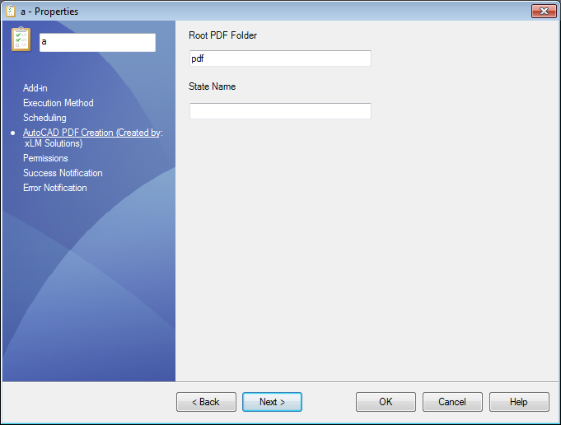
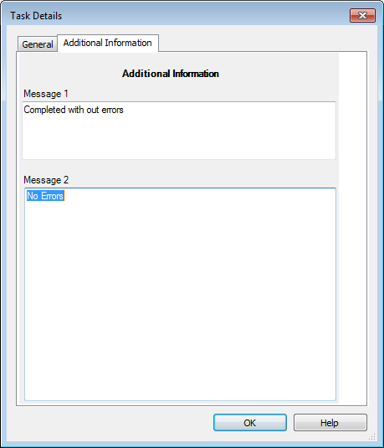
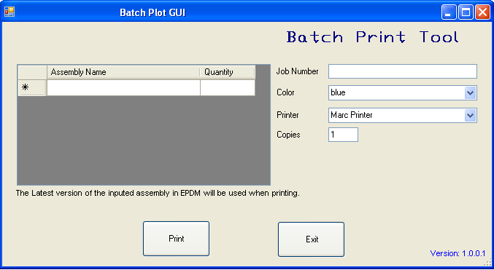
Tasks (2/2)
All aspects of the Task can be configured:
Setup
  Configuration GUI Properties
  On close of the configuration window of the Task
Initialization
  menu bring up a GUI
  On close of the Task Initiates
Execution
  The performing of the task
Task Details
    The Details GUI of a the task

Slide 13
Standalone Exectuables
Standalone Executables are used to perform operations out side of the SOLIDWORKS PDM Vault or not related to an event
To create an Standalone Executable:
Create a Windows Application Project in VB.NET
Reference in the PDMWorks Enterprise Library
Connect to the vault:
Dim vault As EdmVault5
vault = New EdmVault5
Login into the Vault (different login apis)
vault.LoginAuto("MyVaultName", Me.Handle.ToInt32)
Do some work

Slide 14
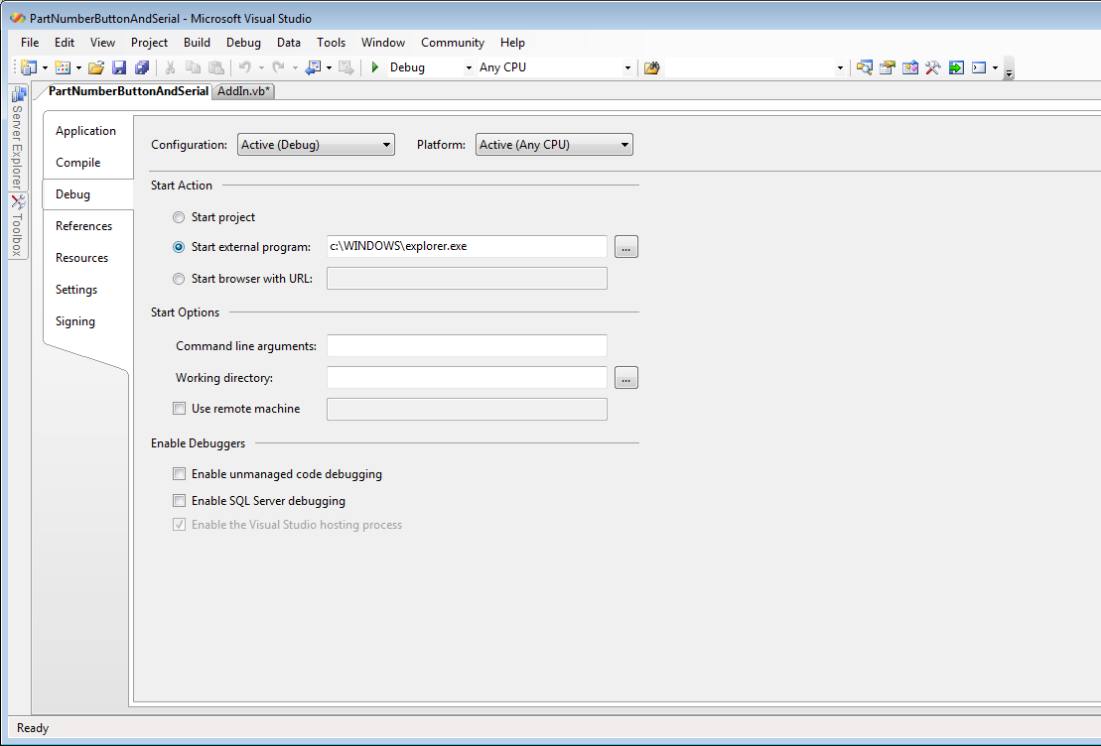
Debugging and Testing
Debugging
  The ability to add an add-in as a debug-addin
  Add explorer.exe to the Debug start external program property:
  Step through the code
Testing
  Very important to test functionality
  Write down various scenarios and test them all
  Develop and Test in test environment before rolling out to production

Slide 15
Add-In Implementation Considerations
Should you implement an Add-In?
  Are users repeatedly making the same mistakes?
  Are certain processes tedious?
Define the functional criteria for the Add-In
Define test cases
Build an environment for testing
  To ensure script will not adversely affect production
Request source code or insure a way for maintaining the script

Slide 16
ROI for a Simple Script
Can we justify the investment?
  Script development cost = $5000.00
  What are the time and cost savings of an automation solution versus developing a script?
    10 engineers
    Engineer cost per hour = $62.50
    10 minutes saving per engineer per day
    200 days in the year
      Savings per engineer per day ($62.5 x 1/6) = $10.42
      Savings per engineer per year ($10.42 x 200) = $2,083.33
      Saving for 10 engineers per year = $20,833.33
ROI in year 1 = $15,833.33 or a 316.67% return
Expand this to year 2, 3, 4, 5, …

Slide 17
ROI Calculator

Slide 18
Conslusion
Customizations is a powerful and economical approach to expand and customize SOLIDWORKS PDM for enterprise PLM needs
Various options of customizations are available
The cost savings and ROI can be significant (even for a 10-min process)

Slide 19

Thank You!
Questions?
Script example shown is available at: http://www.xlmsolutions.com
Marc Young
xLM Solutions, LLC.
248-926-5932
myoung@xlmsolutions.com
Ilan Madjar
xLM Solutions, LLC.
516-792.6974
imadjar@xlmsolutions.com

